Slide 1
CS 4475 Final Project
Sydni Peterson
Jackie Joyce

Slide 2
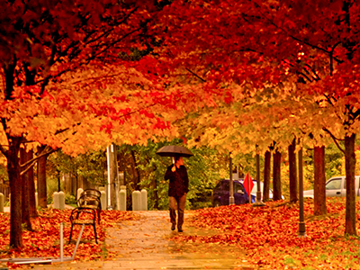
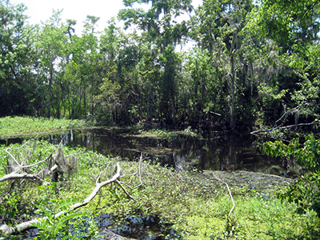
Step 1 - Transfer
Source Image
Target Image

Slide 3
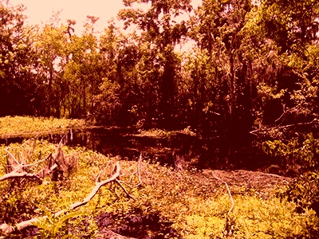
Final Color Transfer Product
Can easily see the new red hue on the target image
Image has had the color transferred over the entire image.
Image is ready for step two

Slide 4
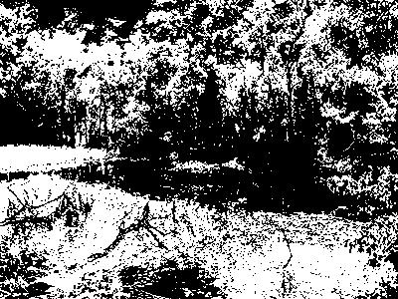
Step 2 – Blending with a Computational Mask
Color Transferred Image
Generated Mask based on Color Channel

Slide 5
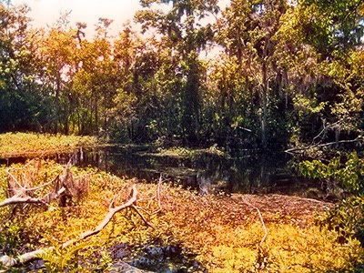
Final Product
Transferred image is blended with original image using the generated mask
Image now has the red hue in where it was previously predominantly green.
Not quite as drastic as transferred image.
Color of water, sky, and very dark green preserved.

Slide 6
Organizational Pipeline
Input
Two different images labeled “source” and “target.”
Step 1
Generate a new image with the transferred color.
Step 2
Blend original and color transferred image using the generated mask
Final
Blended color transferred image based on specified color channel

Slide 7
Input
Two input images are entered into the color transfer image.
One image is labeled “source” and the other is labeled “target.”
These two images will be used in Step 1 to transfer the colors from the source image to the target image.

Slide 8
Step 1
Color transfer function uses mean and standard deviation to transfer the colors from the source to the target
Source image still keeps its original subject, but not has new colors.
Code based off of pyimagesearch.com
Final product is the original image with the the colors of the source image.

Slide 9
Step 2
Generates a mask based off of the user’s input.
User can chose to transfer red values, green values, or blue values above a specified threshold.
Using the mask, the code will blend the product of the color transfer function and the original image.
Had a hard time originally implementing the makeMask() function. Function uses myro library instead of numpy.
Fixed via Computer reboot.

Slide 10
Final Product
Final product will always be a blended version version of the original image and its color transferred counterpart.
Project was successful!
Could not remove all of the targeted colors, though.
Could be due to the wide range of RGB values that could produce red, greens, blues, and everything else in between.
Perhaps, we could create a more comprehensive mask to account for yellows, oranges, and purples.

Slide 11
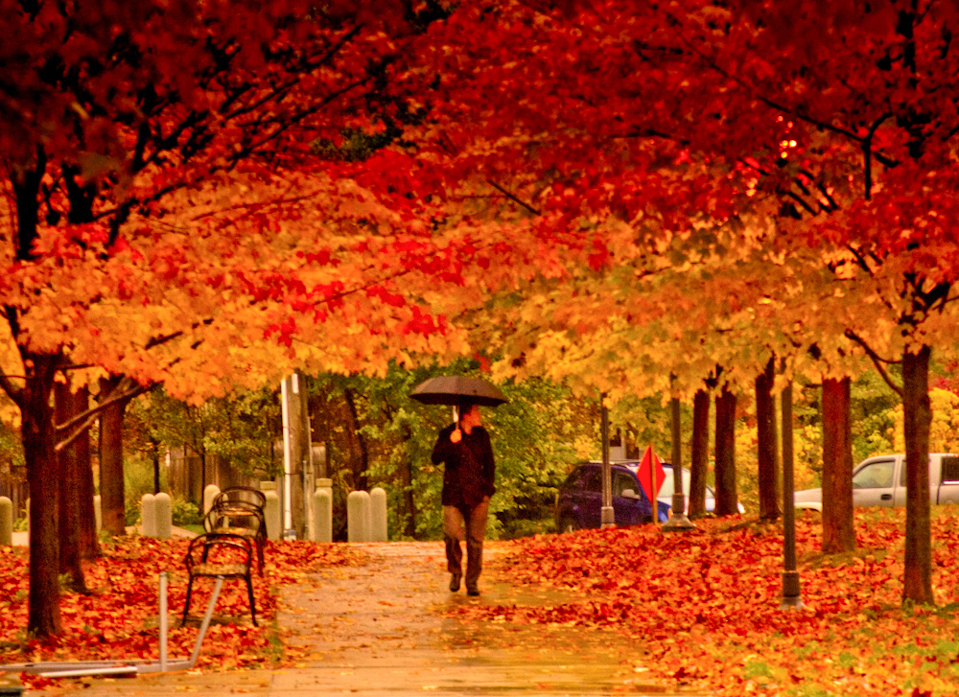

More Examples
Target image
Source Image

Slide 12
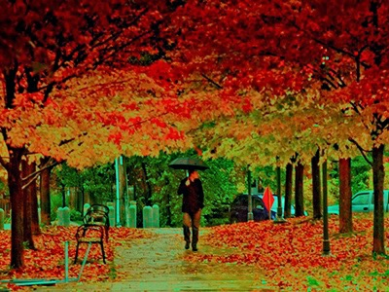
More Examples
Reverse of our original example

Slide 13
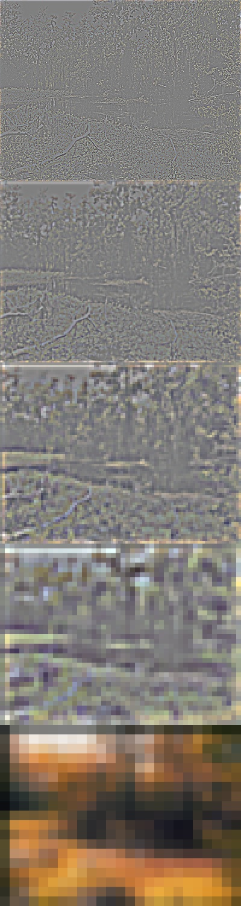
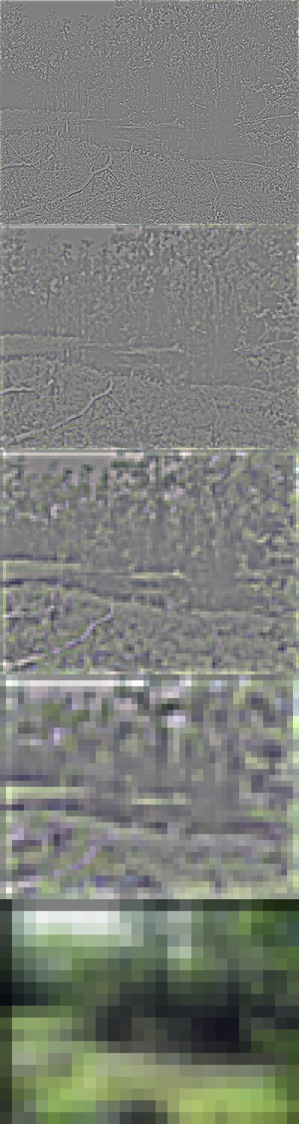
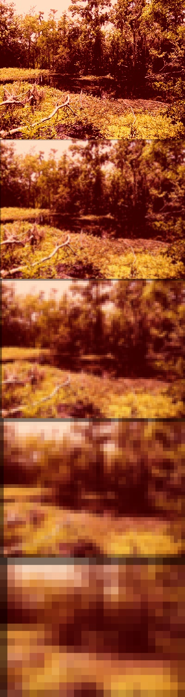
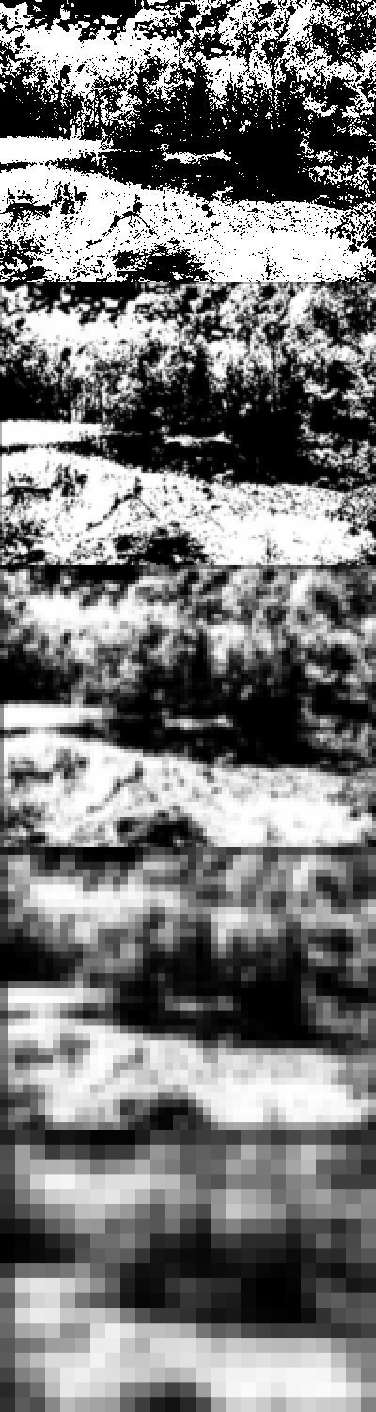
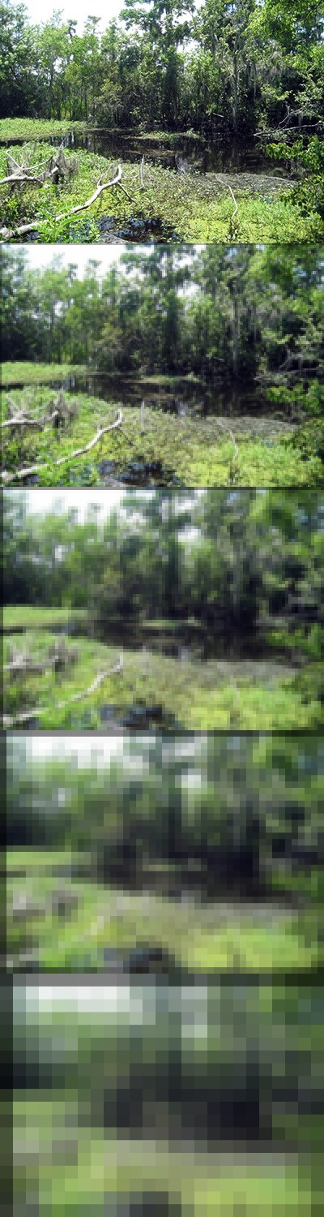
More images….

